Slide 1
Feed focal length distribution with Zemax for AVX Camera

Slide 2
Overview
AVX_EFLvsWAVL.ZPL macro automate the focal length distribution extraction in ANSYS Zemax OpticStudio for feeding AVxcelerate Camera model.
ANSYS AVxcelerate Camera model can model chromatic aberration.
By considering the focal length variation in function of the wavelength
In Avxcelerate Sensor Labs, you must enter the advanced focal length distribution per wavelength in your camera model.
ANSYS Zemax OpticStudio is a software used for designing Lens system offers the ability to such input for ANSYS Avxcelerate Camera

Slide 3
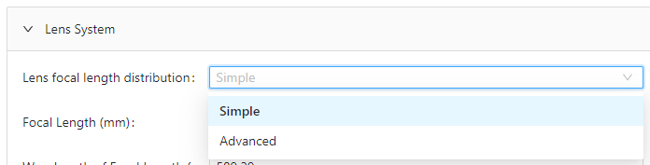

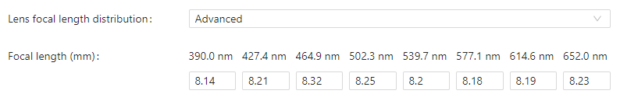
How to fill the advanced focal length distribution in AVX SensorLabs
Three levels of settings for three levels of available information:
User is invited to select the model used for defining the focal length distribution. Select the Advanced model for entering the tabulated focal length per wavelength Note: AVX_EFLvsWAVL.ZPL macro helps to fill only the Advanced model.
Fill the tabulated spectral focal length distribution.
1
2
Note: During data preparation, user must get inputs from its lens supplier or expert from lens designing tool (eg. Zemax).
Advanced

Slide 4
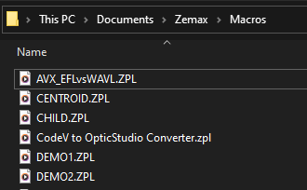
How to obtain focal length distribution in OpticStudio
Set AVX_EFLvsWAVL.ZPL macro in ANSYS Zemax OpticStudio envirronment
Reach “Zemax/Macros” folder under your documents
Paste AVX_EFLvsWAVL.ZPL macro in the directory
1
2

Slide 5
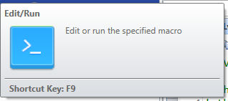
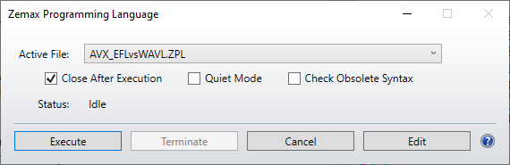
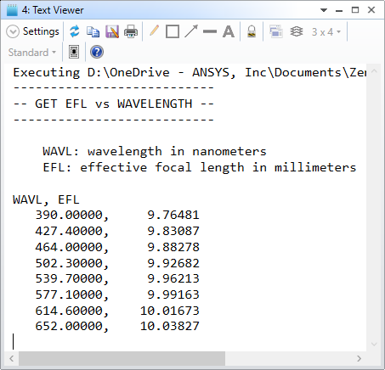

How to obtain focal length distribution in OpticStudio
Get focal length distribution
Once your lens system open OpticStudio:
Click command Edit/Run macros
Select AVX_EFLvsWAVL.ZPL
Click Execute A windows pop-up with the focal length distribution
Report values in your camera model (AVX Sensor Labs)
1
2
3
4
Run it, Done!
Fill spectral focal length in camera sensor form.

